Slide 1

18.404/6.840 Lecture 16
Last time: - NP-completeness
- $3SAT≤_{\text{P}}CLIQUE$
- $3SAT≤_{\text{P}} HAMPATH$
Today: (Sipser §7.4) - Cook-Levin Theorem: $SAT$ is NP-complete
- $3SAT$ is NP-complete
1

Slide 2








Quick Review
Defn: $B$ is NP-complete if
$B∈$NP
For all $A∈$NP, $A≤_{P}B$
If $B$ is NP-complete and $B∈$P then P $=$ NP.
Check-in 16.1
The big sigma notation means summing over some set.
$$\sum_{1≤i≤n}{i}=1+2+⋯+n$$
The big AND (or OR) notation has a similar meaning.
For example, if $x=x_{1}⋯x_{n}$ and $y=y_{1}⋯y_{n}$ are two strings of length $n$, when does the following hold?
$$\left(\bigwedge_{1≤i≤n}{x_{i}}=y_{i}\right)=True$$
Whenever $x$ and $y$ agree on some symbol.
Whenever $x=y$.
today
NP
$$≤_{P}SAT≤_{P}3SAT≤_{P}CLIQUE$$
previously
$≤_{P}SUBSET$-$SUM$
Importance of NP-completeness
1) Evidence of computational intractability.
2) Gives a good candidate for proving P $≠$ NP.
recitation
$$≤_{P}HAMPATH$$
$$≤_{P}UHAMPATH$$
NP
To show some language $C$ is NP-complete,
show $3SAT≤_{P}C$.
P
NP-complete
or some other previously shown NP-complete language
Or:
P = NP
2
Check-in 16.1

Slide 3

Cook-Levin Theorem (idea)
Theorem: $SAT$ is NP-complete
Proof: 1) $SAT∈NP$ (done)
2) Show that for each $A∈NP$ we have $A≤_{P}SAT$:
Let $A∈NP$ be decided by NTM $M$ in time $n^{k}$.
Give a polynomial-time reduction $f$ mapping $A$ to $SAT$.
$f: Σ^{∗}→$formulas
$f\left(w\right) = 〈φ_{M,w}〉$
$w∈A$ iff $φ_{M,w}$ is satisfiable
Idea: $φ_{M,w}$ simulates $M$ on $w$. Design $φ_{M,w}$ to “say” $M$ accepts $w$.
Satisfying assignment to $φ_{M,w}$ is a computation history for $M$ on $w$.
3

Slide 4









Tableau for $M$ on $w$
Defn: An (accepting) tableau for NTM $M$ on $w$ is an $n^{k}×n^{k}$ table representing an computation history for $M$ on $w$ on an accepting branch of the nondeterministic computation.
$$n^{k}$$
˽ … ˽
$$q_{0}$$ | $$w_{1}$$ | $$w_{2}$$ | $w_{3} ⋯ w_{n}$
a | $$q_{7}$$ | $$w_{2}$$ | $⋯$
 |  |  | $⋯ q\text{accept} ⋯$
$←$Start configuration for $M$ on $w$
Construct $φ_{M,w}$ to “say” $M$ accepts $w$.
$φ_{M,w}$ “says” a tableau for $M$ on $w$ exists.
$φ_{M,w}=φ\text{cell} ∧ φ\text{start}$ $∧ φ\text{move}$ $∧ φ\text{accept}$
$$⋮$$
$$n^{k}$$
$←$Accepting configuration
4

Slide 5















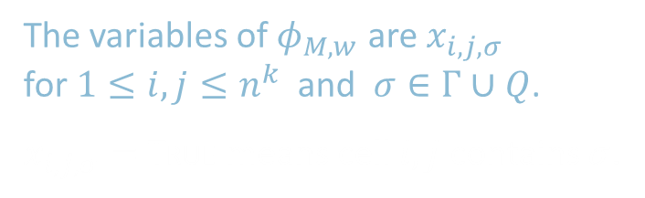









Constructing $φ_{M,w}$: $φ\text{cell}$
$$j$$
˽ … ˽
$$q_{0}$$ | $$w_{1}$$ | $$w_{2}$$ | $w_{3} ⋯ w_{n}$
a | $$q_{7}$$ | $$w_{2}$$ | $⋯$
 |  |  | $⋯ q\text{accept} ⋯$
˽
˽
$$q_{7}$$
$$i,j$$
$$q_{7}$$
a
a
˽
˽
a
$$i$$
a
$$q_{7}$$
$$q_{7}$$
$φ_{M,w}$ “says” a tableau for $M$ on $w$ exists.
$φ_{M,w}=φ\text{cell} ∧ φ\text{start}$ $∧ φ\text{move}$ $∧ φ\text{accept}$
a
b
˽
$$q_{7}$$
Check-in 16.2
How many variables does $φ_{M,w}$ have? Recall that $n=|w|$.
$O(n)$
$O(n^{2})$
$O(n^{k})$
$O(n^{2k})$
$$⋯$$
$$⋯$$
$$⋯$$
Cell $i,j$ can contain any symbol in $Γ∪Q$
$φ\text{cell}$ “says” exactly one light is on per cell
i.e., exactly one $x_{i,j,σ}=$ True for each $i,j$ .
lights represent $x_{i,j,σ}$
$x_{i,j,q_{7}}$= True
$x_{i,j,\text{˽}}$ = True
$x_{i,j,\text{a} }$= True
In every cell at least one light and at most one light
The variables of $φ_{M,w}$ are $x_{i,j,σ}$ for $1≤i,j≤n^{k}$ and $σ∈Γ∪Q$.
$x_{i,j,σ}=$ True means cell $i,j$ contains $σ$.
$$x_{i,j,σ_{1}} ∨ x_{i,j,σ_{2}} ∨⋯∨ x_{i,j,σ_{t}}$$
1≤𝑖,𝑗≤𝑛𝑘𝜎∈Γ∪𝑄𝑥𝑖,𝑗,𝜎 ∧ 𝜎,𝜏∈Σ∪𝑄𝜎≠𝜏 𝑥𝑖,𝑗,𝜎∧𝑥𝑖,𝑗,𝜏
$$\bigvee_{σ∈Γ∪Q}{x_{i,j,σ}}$$
$$∧$$
$$\bigwedge_{{σ,τ ∈Γ∪Q \atop σ ≠ τ}}{\left( \overline{x_{i,j,σ}∧x_{i,j,τ}} \right) }$$
$$φ\text{cell} =$$
5
Check-in 16.2

Slide 6





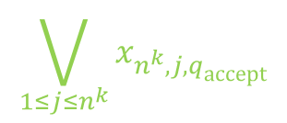



Constructing $φ_{M,w}$: $φ\text{start}$ and $φ\text{accept}$
1 $⋯ n^{k}$
1
2
3 $⋯ n^{k}$
1
˽ … ˽
$←$Start configuration
$$q_{0}$$ | $$w_{1}$$ | $$w_{2}$$ | $w_{3} ⋯ w_{n}$
a | $$q_{7}$$ | $$w_{2}$$ | $⋯$
 |  |  | $⋯ q\text{accept} ⋯$
$φ_{M,w}$ “says” a tableau for $M$ on $w$ exists.
$φ_{M,w}=φ\text{cell} ∧ φ\text{start}$ $∧ φ\text{move}$ $∧ φ\text{accept}$
$φ\text{cell}$ done ✓
$φ\text{start}$ $=x_{1,1,q_{0}} ∧ x_{1,2,w_{1}}∧ x_{1,3,w_{2}}∧ ⋯ ∧x_{1,n^{k},\text{˽}}$
$φ\text{accept}$ $=$
$$n^{k}$$
$←$Accepting configuration
$$\bigvee_{1≤j≤n^{k}}{x_{n^{k},j,q\text{accept}}}$$
6

Slide 7















Constructing $φ_{M,w}$: $φ\text{move}$
$$j$$
˽ … ˽
$$q_{0}$$ | $$w_{1}$$ | $$w_{2}$$ | $w_{3} ⋯ w_{n}$
a | $$q_{7}$$ | $$w_{2}$$ | $⋯$
 |  |  | $⋯ q\text{accept} ⋯$
$2×3$ neighborhood
$$i$$
Legal neighborhoods: consistent with $M$’s transition function
potential examples:
a | $$q_{7}$$ | b
$$q_{3}$$ | a | c
a | b | c
a | b | c
a | b | c
a | b | $$q_{5}$$
a | b | c
d | b | c
Illegal neighborhoods: not consistent with $M$’s transition function
$φ_{M,w}$ “says” a tableau for $M$ on $w$ exists.
$φ_{M,w}=φ\text{cell} ∧ φ\text{start}$ $∧ φ\text{move}$ $∧ φ\text{accept}$
examples:
a | b | c
a | d | c
a | b | c
a | $$q_{2}$$ | c
a | $$q_{7}$$ | c
a | b | c
a | $$q_{7}$$ | c
$$q_{3}$$ | d | $$q_{4}$$
✓
✓
✓
Claim: If every $2×3$ neighborhood is legal then tableau corresponds to a computation history.
1<𝑖,𝑗<𝑛𝑘𝜎∈Γ∪𝑄𝑥𝑖,𝑗,𝜎 ∧ 𝜎,𝜏∈Σ∪𝑄𝜎≠𝜏 𝑥𝑖,𝑗,𝜎∧𝑥𝑖,𝑗,𝜏
$$\bigvee{ \left( x_{i,j−1,\text{r} } ∧ x_{i,j,\text{s} } ∧ x_{i,j+1,\text{t} } ∧ x_{i+1,j−1,\text{v} } ∧ x_{i+1,j,\text{y} } ∧ x_{i+1,j+1,\text{z} } \right) }$$
$$φ\text{move} =$$
Legal
Says that the neighborhood at $i,j$ is legal
r | s | t
v | y | z
7

Slide 8





Conclusion: $SAT$ is NP-complete
$$n^{k}$$
˽ … ˽
$$q_{0}$$ | $$w_{1}$$ | $$w_{2}$$ | $w_{3} ⋯ w_{n}$
a | $$q_{7}$$ | $$w_{2}$$ | $⋯$
 |  |  | $⋯ q\text{accept} ⋯$
Summary:
For $A∈\text{NP}\text{,}$ decided by NTM $M$, we gave a reduction $f$ from $A$ to $SAT$:
$f: Σ^{∗} →$formulas
$f\left(w\right) = 〈φ_{M,w}〉$
$w∈A$ iff $φ_{M,w}$ is satisfiable.
$φ_{M,w}=φ\text{cell} ∧ φ\text{start}$ $∧ φ\text{move}$ $∧ φ\text{accept}$
The size of $φ_{M,w}$ is roughly the size of the tableau for $M$ on $w$, so size is $O\left(n^{k}×n^{k}\right)=O\left(n^{2k}\right)$.
Therefore $f$ is computable in polynomial time.
$$n^{k}$$
8

Slide 9













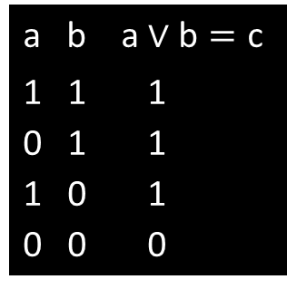



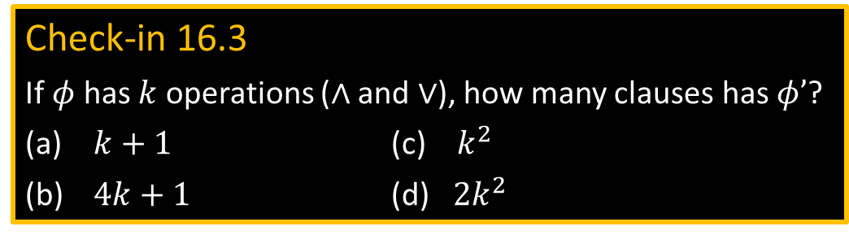
$3SAT$ is NP-complete
a b a $∨\text{b}=\text{c}$
1 1 1
0 1 1
1 0 1
0 0 0
a b a $∧\text{b}=\text{c}$
1 1 1
0 1 0
1 0 0
0 0 0
$$\left(\text{a}∧\text{b}\right)→\text{c}$$
$$\left(\overline{\text{a}}∧\text{b}\right)→\text{c}$$
$$\left(\text{a}∧\overline{\text{b}}\right)→\text{c}$$
$$\left(\overline{\text{a}}∧\overline{\text{b}}\right)→\overline{\text{c}}$$
$$\left(\text{a}∧\text{b}\right)→\text{c}$$
$$\left(\overline{\text{a}}∧\text{b}\right)→\overline{\text{c}}$$
$$\left(\text{a}∧\overline{\text{b}}\right)→\overline{\text{c}}$$
$$\left(\overline{\text{a}}∧\overline{\text{b}}\right)→\overline{\text{c}}$$
Theorem: $3SAT$ is NP-complete
Proof: Show $SAT≤_{P}3SAT$
Give reduction $f$ converting formula $φ$ to 3CNF formula $φ′$, preserving satisfiability.
(Note: $φ$ and $φ′$ are not logically equivalent)
Example: Say $φ=\left(\left(\text{a}∧\text{b}\right) ∨ \text{c}\right) ∧ \left(\overline{\text{a}}∨\text{b}\right)$
Tree structure for $φ$:
Logical equivalence: $\left(A→B\right)$ and $\left(\overline{A}∨B\right)$ $\overline{\left(A∧B\right)}$ and $\left(\overline{A}∨\overline{B}\right)$
$$φ^{′}= \left(\left(\text{a}∧\text{b}\right)→z_{1}\right) ∧ \left(\left(\overline{\text{a}}∧\text{b}\right)→\overline{{\text{z}}_{1}}\right) ∧ \left(\left(\text{a}∧\overline{\text{b}}\right)→\overline{{\text{z}}_{1}}\right) ∧ \left(\left(\overline{\text{a}}∧\overline{\text{b}}\right)→\overline{{\text{z}}_{1}}\right)$$
$$z_{4}$$
$$∧$$
$$∧ \left(\left(z_{1}∧\text{c}\right)→z_{2}\right)∧\left(\left(\overline{{\text{z}}_{1}}∧\text{c}\right)→z_{2}\right) ∧ \left(\left(z_{1}∧\overline{\text{c}}\right)→z_{2}\right) ∧ \left(\left(\overline{{\text{z}}_{1}}∧\overline{\text{c}}\right)→\overline{{\text{z}}_{2}}\right)$$
$$z_{2}$$
$$∨$$
$$∨$$
$$z_{3}$$
$⋮$ repeat for each $z_{i}$
$$∧ (z_{4})$$
Check-in 16.3
If $φ$ has $k$ operations ($∧$ and $∨$), how many clauses has $φ’$?
$k+1$ (c) $k^{2}$
$4k+1$ (d) ${2k}^{2}$
$$z_{1}$$
$$∧$$
c
$$\overline{\text{a}}$$
b
Observe that $\left(\left(\text{a}∧\text{b}\right)→\text{c}\right)$ is logically equivalent to $\left(\overline{\text{a}}∨\overline{\text{b}}∨\text{c}\right)$
a
b
$$\left[ \left(\left(\text{a}∧\text{b}\right)→\text{c}\right) ↔ \left(\overline{\left(\text{a}∧\text{b}\right)} ∨\text{c}\right) ↔ \left(\left(\overline{\text{a}}∨\overline{\text{b}}\right)∨\text{c}\right) ↔ \left(\overline{\text{a}}∨\overline{\text{b}}∨\text{c}\right) \right]$$
9
Check-in 16.3

Slide 10

Quick review of today
$SAT$ is NP-complete
$3SAT$ is NP-complete
10

Slide 11
MIT OpenCourseWare
https://ocw.mit.edu
18.404J Theory of Computation
Fall 2020
For information about citing these materials or our Terms of Use, visit: https://ocw.mit.edu/terms.

